Slide 1
The Flying Spaghetti Monster
How His Noodley Appendage Touches You

Slide 2
About Me
Name: Addison Babcock
Age: 21
I am a second semester computer engineering tech. student, studying a NAIT
I come from a Christian background, but I consider myself to be Atheist.

Slide 3
What I Expect From You
I will be taking about 10 to 15 minutes of your time.
I ask that you keep all questions until the end of the presentation.
It is very important that you maintain an open mind throughout my presentation.

Slide 4
About This Presentation
I will be covering a few topics today:
  What is a Flying Spaghetti Monster?
  Some General Information About Pastafarianism
  What FSM Means to You
  Supporting Evidence and Testimonies

Slide 5
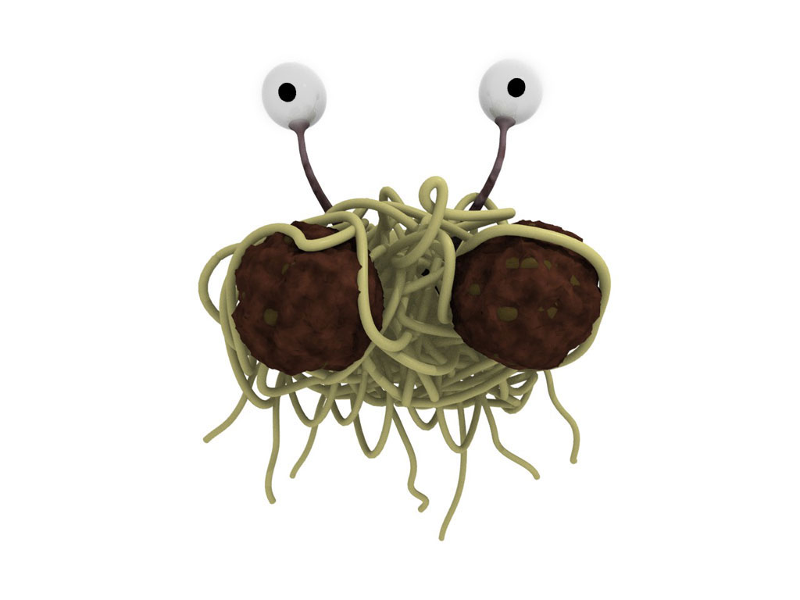
What is a Flying Spaghetti Monster?
The Flying Spaghetti Monster (or FSM for short) is a supernatural entity that influences our daily lives.

Slide 6
What is a Flying Spaghetti Monster?
He moves about all the universe with great ease, using His Noodley Appendages to change whatever He pleases.
He rarely makes himself visible, but when He does the vision is so awe-inspiring that it can be misinterpreted.
The following is an image of what really happened during the last supper.

Slide 7
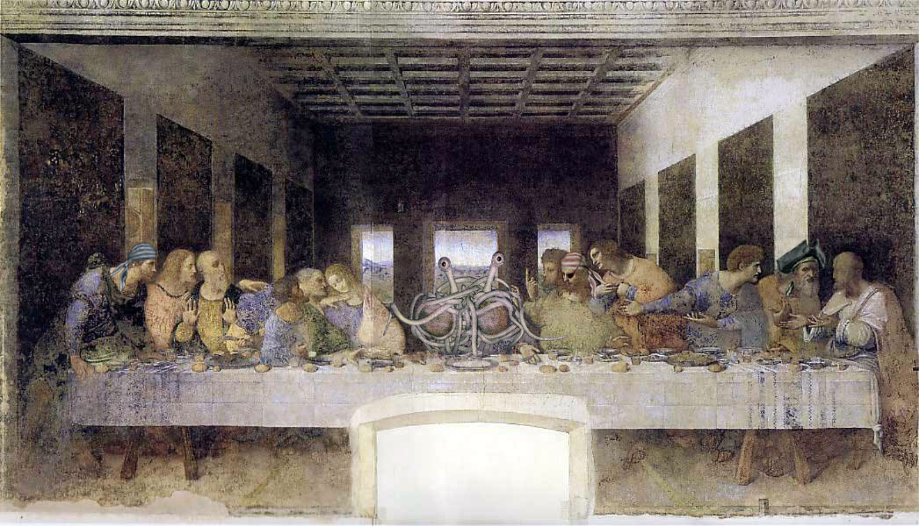
What is a Flying Spaghetti Monster?

Slide 8
General Information About Pastafarianism
We believers choose to be identified as Pastafarians.
  This is mainly because spaghetti is a pasta.
Our holy meals typically consist of spaghetti and meatballs, Ramen noodles and other high sources of protein.
Our traditions include the annual celebration known as “Happy Holidays”
  Happy Holidays occurs near the end of December, but celebrations often begin shortly after Halloween

Slide 9
General Information About Pastafarianism
Our story of creation is slightly different then what most people are familiar with.
  In the beginning, there was nothing.
  Then, He created a mountain, some trees and finally, a midget.

Slide 10
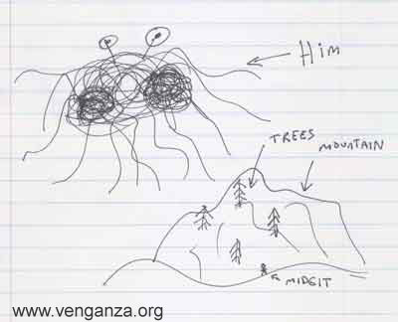
General Information About Pastafarianism

Slide 11
General Information About Pastafarianism
I have located a short video describing the creation of the earth.
  It can be seen at:
    http://www.venganza.org/2006/11/07/fsm-animation.htm

Slide 12
General Information About Pastafarianism
We Pastafarians also believe that the lack of pirates in modern times is a direct cause of global warming.
  FSM loves pirates. Because of a lack of pirates, he becomes very angry and hot. Since His Noodley Appendage is always touching all of us, this heats the earth.
I have a graph to demonstrate this relationship:

Slide 13
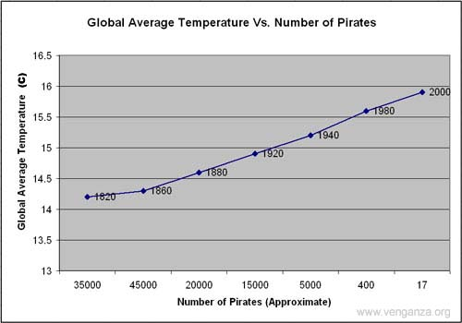
General Information About Pastafarianism

Slide 14
General Information About Pastafarianism
Because of this obvious relationship it is considered proper form to be fully dressed as a pirate when speaking publicly about FSM.
On the next slide, I have a picture of the correct apparel.

Slide 15
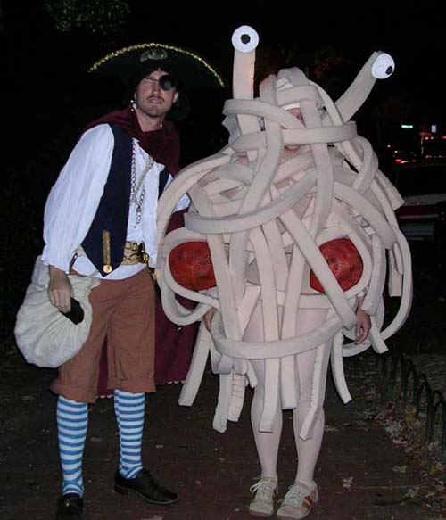
General Information About Pastafarianism

Slide 16
What Does FSM Mean To Me?
FSM performs various random miracles
  He does this using His Noodley Appendage
  When you receive a miracle, it is said that you have been “touched by His Noodley Appendage”

Slide 17
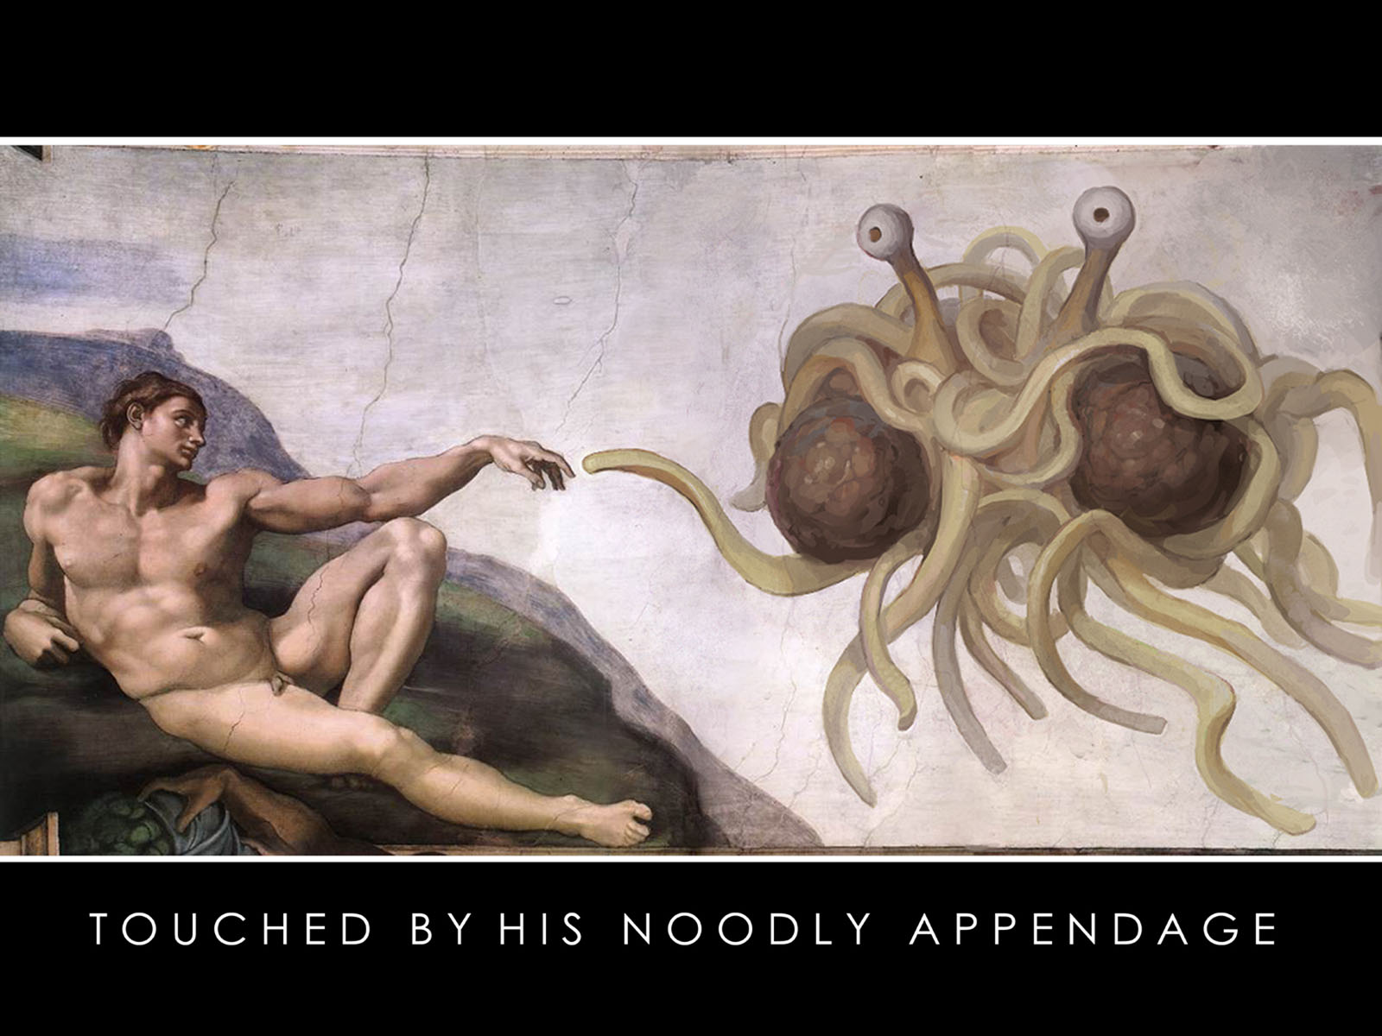
What Does FSM Mean To Me?

Slide 18
What Does FSM Mean To Me?
Our heaven is also different then the Christian heaven.
  We have a stripper factory and a beer volcano
    The factory also produces male strippers for the ladies
  This makes our heaven much cooler then the Christian version
  When you die would you rather a plain old boring heaven? Or do you want to get drunk and watch strippers all day?

Slide 19
Evidence And Testimonies
“I have now read and reread the information on Flying Spaghetti Monsterism (FSM) and I have to admit that it is frankly on par with (and in many ways superior to) the alternative proposed by the Kansas School Board.”
  Lynne Anne Daurelle, Ph.D.

Slide 20
Evidence And Testimonies
“Based on Mr. Henderson’s letter, it is clear that the FSM theory has evidence comparable in weight to ID.”
  Elizabeth Garrett-Mayer, PhD
“MMMMMmmmmm, spaghetti”
  H. Neville, Ph.D.

Slide 21
Evidence And Testimonies
“The riducule of FSMism by believers in ID is a beautifully ironic hypocracy. It is a classic case of faith-blindness and the worst of intellectual behaviour that can be observed in religion. In this instance the believers in ID run roughshod over the believers in FSMism by claiming their ‘Faith’ is correct and decrying the FSM ‘Faith’ as wrong. It is not possible to scientifically qualify ‘Faith’ and thus a comparison of ‘Faith’ in this fashion is meaningless and offensive. If no evidence can be provided to support either then both are equally valid or invalid, regardless of how angry or indignant the supporters may be.”
  Andy Parsons, Ph.D.

Slide 22
Evidence And Testimonies
I have located video footage of a recent sighting of FSM
  http://www.youtube.com/watch?v=vL7FcvEydqg&eurl=
  This video is real unedited footage.

Slide 23
Conclusion
I would really like for you to go home and try to compare Christianity with Pastafarianism.
  I believe that you will find that the only differences are superficial and that Pastafarianism is every bit as valid as Intelligent Design.

Slide 24
More Information
For more information about the Flying Spaghetti Monster and His followers, visit the official webpage of The Church Of The Flying Spaghetti Monster
  http://www.venganza.org
Also, The Gospel Of The Flying Spaghetti Monster can be bought on Amazon.com

Slide 25
Citations and References
Slide 10 & 13 images:
  Henderson, Bobby. "Open Letter To Kansas School Board." Church of the Flying Spaghetti Monster. 14 Sept 2006. 9 Nov 2006 <http://www.venganza.org/about/open-letter/>.
Slide 7 image:
  9 Nov 2006 <http://www.venganza.org/images/wallpapers/Last-Supper.jpg>.
Slide 17 image:
  9 Nov 2006 <http://www.venganza.org/images/wallpapers/noodledoodle1600_1200.jpg>.
Slide 15 image:
  10 Nov 2006 <http://www.venganza.org/spread-the-word/costumes/>
Slide 5 image:
  9 Nov 2006 <http://www.venganza.org/images/wallpapers/3d1024x768.jpg>.
Quotes:
  9 Nov 2006 <http://www.venganza.org/evidence/>

